Slide 1
BOX-CITY
Urban Design / Community
Spring 2020
Hilliard Art Museum
Grades 3-12

Slide 2
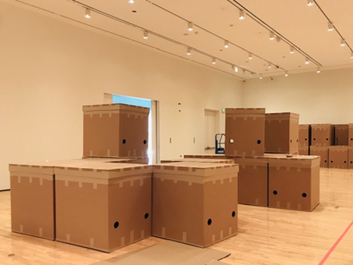
Robert C. Tannen | BOX-CITY is an interactive exhibition using cardboard boxes as to-scale models that allow museum visitors to explore designing their own city.

Slide 3
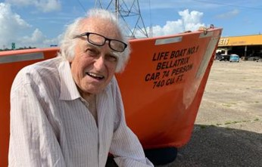
Robert C. Tannen is an artist and regional planner, who lives in New Orleans, LA. He designed BOX-CITY to encourage people to think about how we will live in the future.

Slide 4
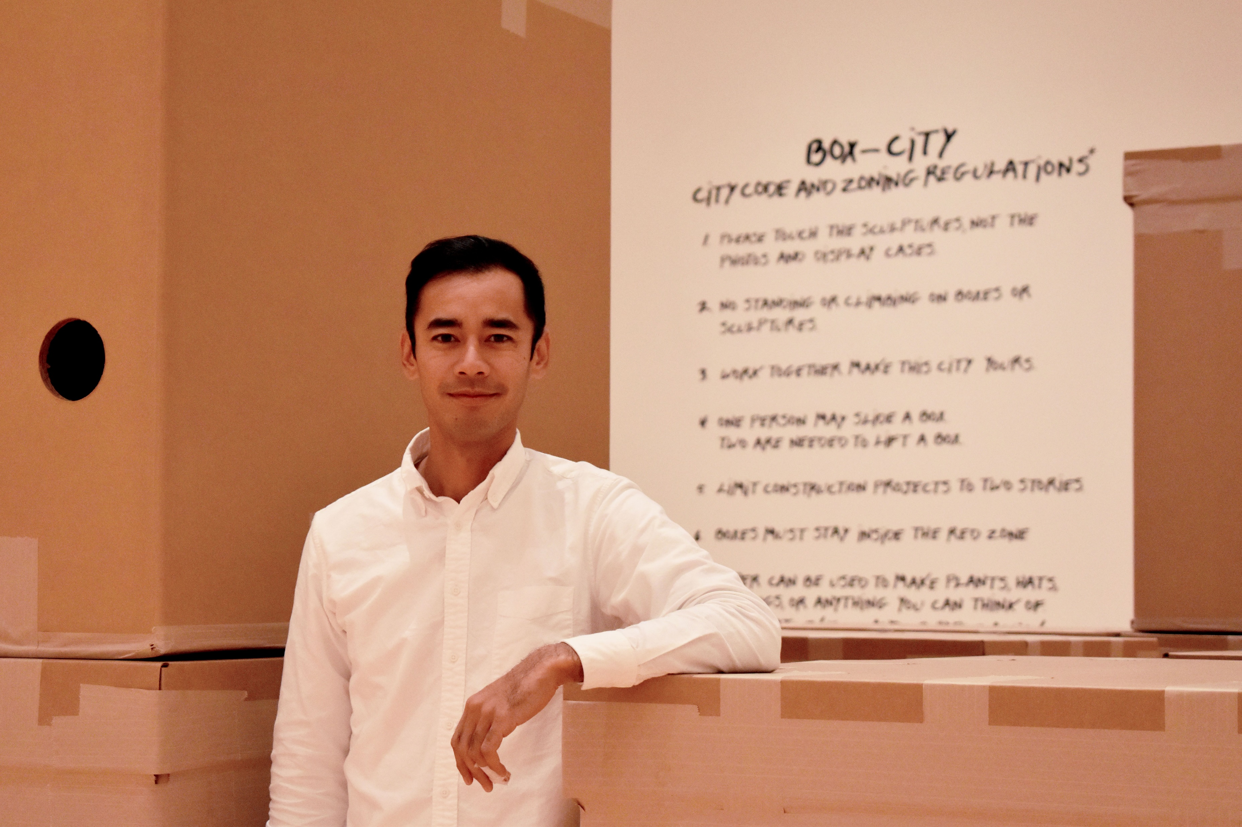
Phanat is an urban designer and community organizer. He lives and works in New Iberia, LA. He is the Hilliard Art Museum’s Teaching Artist in Residence for Spring 2020 and will be your guide at the museum.

Slide 5
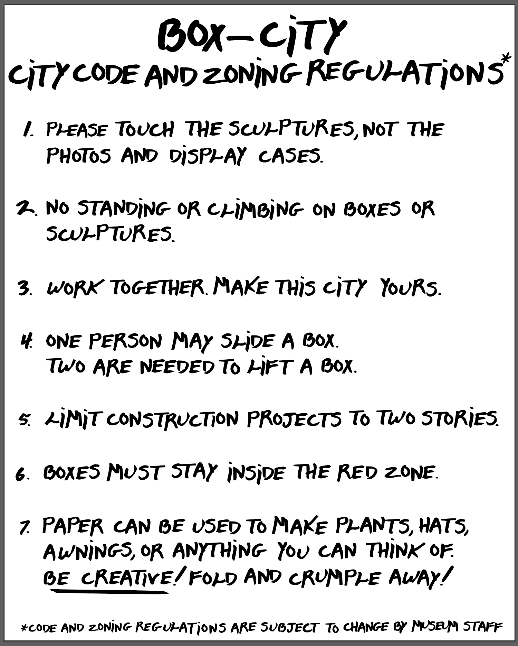
BOX-CITY
Building Code
Guidelines for Building

Slide 6
Human Ecosystem
Urban designers are adopting the human ecosystem as an organizing concept for ecosystem management or city planning.
Key elements of a human ecosystem model:
critical resources
(natural, socioeconomic, and cultural)
social system
institutions, social cycles and social order
Images: Adapted from Gary E. Machlis, Jo Ellen Force & William R. Burch JR. (1997) The human ecosystem Part I: The human ecosystem as an organizing concept in ecosystem management, Society & Natural Resources, 10:4, 347-367, DOI: 10.1080/08941929709381034

Slide 7
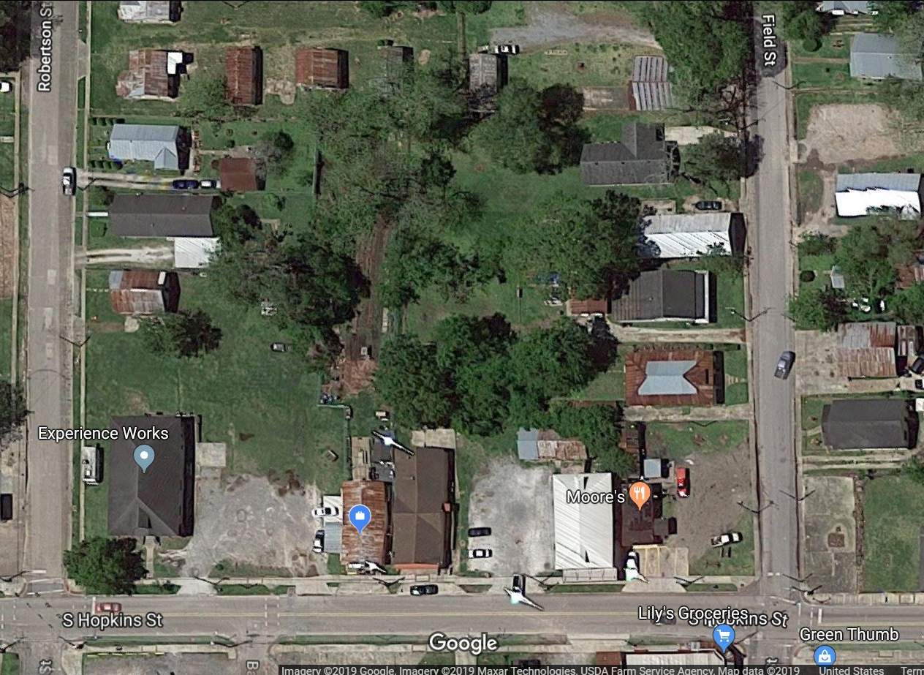
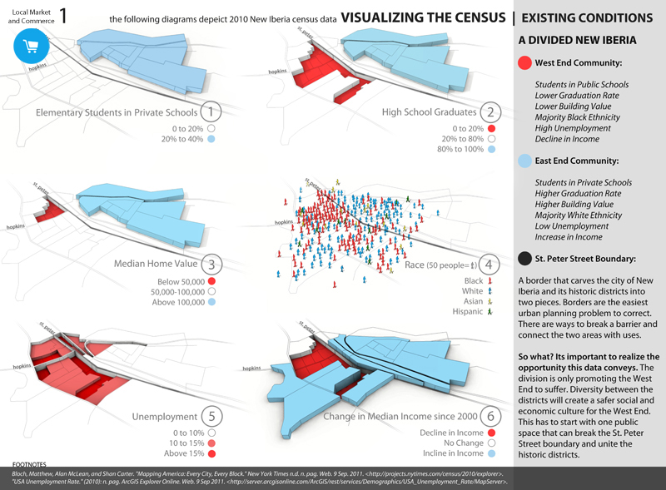
Case Study: West End Community
Since 2000, the population of New Iberia has declined by 6.1%, while Iberia Parish has not grown at all. The rest of the United States has grown in population 9.4%. America is growing, but we are shrinking. For years people have left Iberia Parish following high school graduation to pursue educational or higher-paying opportunities elsewhere, and this “brain drain” has resulted in an overall decline in the physical, mental, and economic health of Iberia Parish residents
Image source: top: Google Maps; bottom: LSU School of Architecture: Envision da Berry Studio 2012.

Slide 8

Listen
Watch the video of West End residents to identify assets, needs, and wants.
What do artists, business owners, and residents say about their community?
https://youtu.be/rLiowcf1VUo

Slide 9
Additional Resources

Slide 10
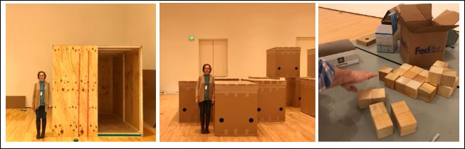
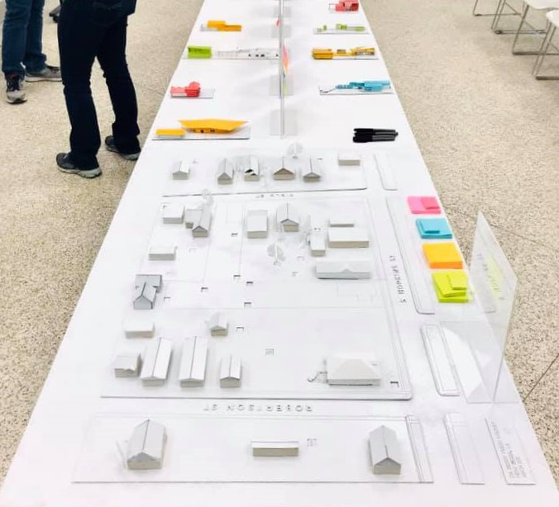
MODEL - a tool for urban designers to visualize and represent an idea , place, or thing.
SCALE MODEL- a representation of something in which all the parts have dimensions in the same mathematical proportion as the original
You’ll have an opportunity to interact directly with these models of different scales to design a community in your vision.
Image Source: photos by Phanat Xanamane

Slide 11
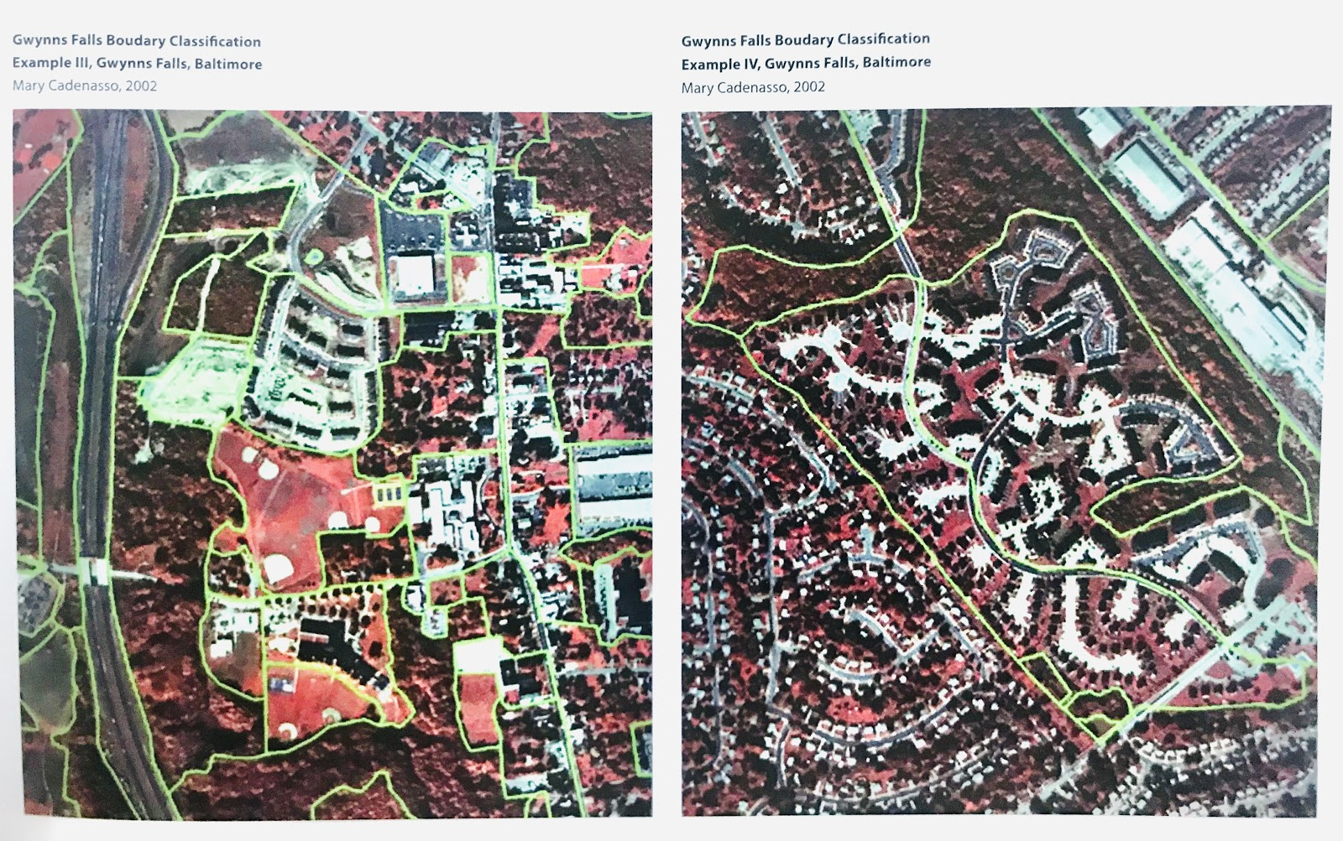
Zones & Patch Dynamics
Zone- a section of a town or city that is created for a particular use. Ex. business zone or residential zone
Patch- a spatial area that is different from its neighboring areas
Ecologists use patch maps to study how different types of patches interact and change over time. Patch dynamics has been adopted by urban designers to map land use and flow of people or materials through a community.
Image Source: Designing Patch Dynamics, Mary Cadenasso 2002

